Slide 1
Lifecycle and Workflow
Notes:
Place the audio notes for this slide here

Slide 2

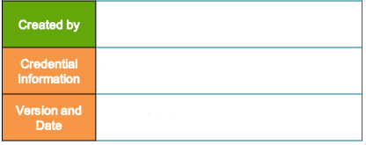
Prathap Mohan Sundararajan (409446)
Enterprise Content Management competence
V 0.1, 15th February 2018

Slide 3
Agenda
Purpose of Lifecycles
Components of Lifecycles
Entry-criteria, action on entry, post-entry action
Basic Lifecycle operations
Creating a lifecycle using composer
Purpose of workflow
Object model and relationships
Designing workflow template

Slide 4
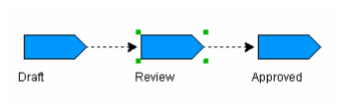
What is a Lifecycle?
A lifecycle is a set of linearly connected states of an object’s life
States are connected linearly
Implemented as a dm_policy object
An object attached to a lifecycle progresses through the states like “Draft”, “Review”, “Approved” as it moves through its lifetime

Slide 5
Lifecycle and a Business Process
Lifecycles allow you to apply your business process to the management of content.
Business process can be mapped into a lifecycle state where each state has its own behavior such as change of location, permission and ownership.
Workflow can also be used along with a lifecycle to manage content throughout the business process.

Slide 6
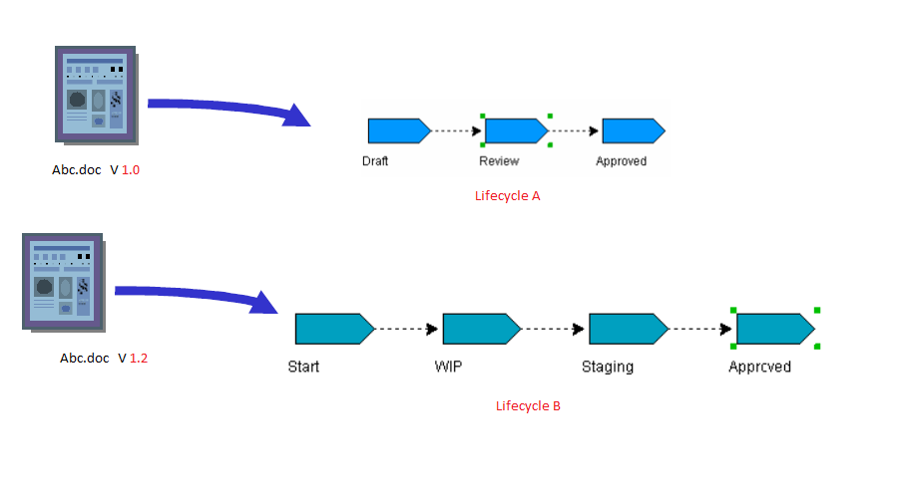
Attaching Objects to a Lifecycle
An object becomes associated with an lifecycle when the lifecycle is applied to the object
An object can only be associated with one lifecycle at a time. Having said that different version of the same object can be associated with different lifecycle.

Slide 7
Attaching Objects to a Lifecycle
What can be attached to a Lifecycle?
All dm_sysobjects and its subtypes can be attached to a lifecycle except dm_policy objects (lifecycle cannot be attached to a lifecycle)
Default lifecycles for an object types
A default lifecycle can be defined for an object type. When user creates an object of that type, they can attach the lifecycle to the object without identifying the lifecycle specifically.

Slide 8
Workflow vs Lifecycle.
Lifecycle | workflow
It is not possible to route document to any user’s inbox. | Routes documents to single or multiple users inbox
There is no task related to any document lifecycle, so it is not possible to implement complex business logic. | Users need to perform a predefined task on the routed document.
Lifecycle state progresses sequentially from start to end. | Workflow can have complex network of task flow to implement a business rule.
Can not handle multiple documents deriving from different parents. It can only handle dm_sysobjects and its sub types. | Can route any document types.
Lifecycle is a flag to indicate the state of a single document like draft – reviewed – final – approved. | Workflow is not concerned with any state of the packaged documents. It just controls the flow of the package through the business rule network.

Slide 9
Lifecycle State of the state
At any point, the state of a document associated to a lifecycle can have two states
Normal
exception
Normal state is the typical state of an object’s life.
Exception state represent situation outside of the normal states of an object’s life
All lifecycles must have normal states but exception states are optional.
Each normal state in a lifecycle definition can have one exception state.

Slide 10
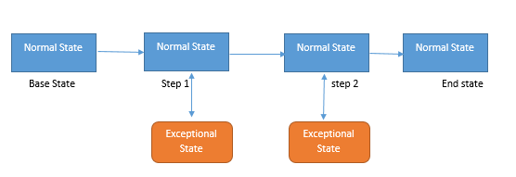
Lifecycle State of the state
Note:
Incase, if a exceptional state is defined for a normal state, one can suspend the document progress by simply moving the object to the exceptional state and vise versa.

Slide 11
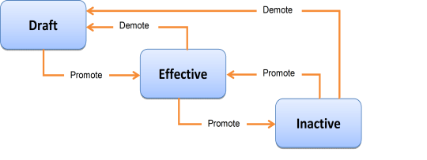
Promotion and Demotion
A document in any normal state can be promoted to the next normal state
A document in any normal state can be demoted to the previous state or back the base state.
A document remains in that state until it is promoted or demoted.

Slide 12
Lifecycle stage criterion
Each stage in a lifecycle may have three criterions
Entry criteria
Entry criteria are typically conditions that an object must fulfill to be a candidate to enter the state.
Actions on entry
Actions on entry are typically operations to be performed if the object meets the entry criteria. For example, changing the ACL might be an action on entry.
Post-entry actions
Post-entry actions are operations on the object that occur after the object is successfully moved to the state. For example, placing the object in a workflow might be a post-entry action.

Slide 13
Entry Criteria
Conditions that must be met before the document can be :
Promoted: Move the document to the next normal state
Suspended: Move the document to the exceptional state
Resumed: Move the document from exceptional state to the normal state
Entry criteria are configured individually for each state and can consist of:
One or more Boolean expressions testing value of attributes.
A Java or Docbasic procedure that can perform complex criteria checks

Slide 14
Action on Entry criteria
Operation that are to be performed if the object meets the entry criteria.
Note: The action must be successful before the object can enter next state.
Sample actions:
Set attribute values
Request a rendition
Add/Remove on a repeating attributes
Change owners
Change permission set

Slide 15
Post Entry criteria
Action performed after the object enters the state
Can be configured each state either as a Java or Docbasic program.
Sample of actions:
Routing the object in a workflow
Sending notification
Sending the object to an automated publishing program

Slide 16
Lifecycle and permission
To apply a lifecycle to an object, user must meet following condition:
Must have relate permission on lifecycle
Be an object owner of the document
To promote an object to the next lifecycle state, user must meet following condition:
Must have Write permission on the object
Must have Change State permission on the object

Slide 17
Lifecycle Actions and permission
The user account that is used to perform lifecycle actions is configured globally in the repository as one of the following:
Current user
Super user
Lifecycle owner
Specific user
This value is set in dm_docbase_config.a_bpaction_run_as
The user should have specific extended permission on an object to perform certain actions successfully:
Change owner
Change state
Change Location
Change permission
Run Procedure

Slide 18
Creating a Lifecycle - 01
Lifecycle can be created using different ways, for our training convenience we are using documentum composer for creating a lifecycle
Checks to be performed before creating Lifecycle.
Docbrocker details and server details updated in dfc.properties file of composer.
Make sure you have an object type available in repository for applying lifecycle( for our example, we are have created an object type “coetraindocuments”).

Slide 19
Creating a Lifecycle - 02
You can now create the lifecycle to which objects of type “coetraindocuments” can be attached.
Go to File menu:
New–> Other–> Documentum Artifact–> select Lifecycyle

Slide 20
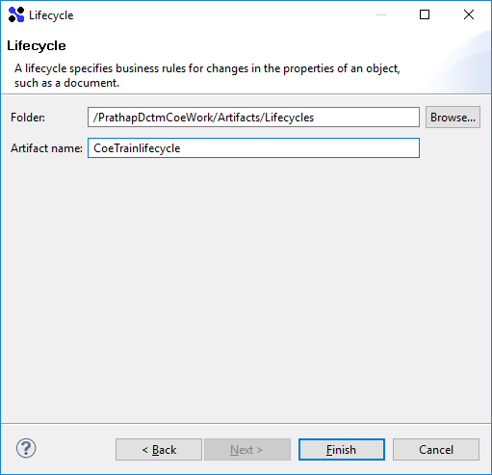
Creating a Lifecycle - 03
Enter a lifecycle name as CoeTrainlifecycle and click Finish

Slide 21
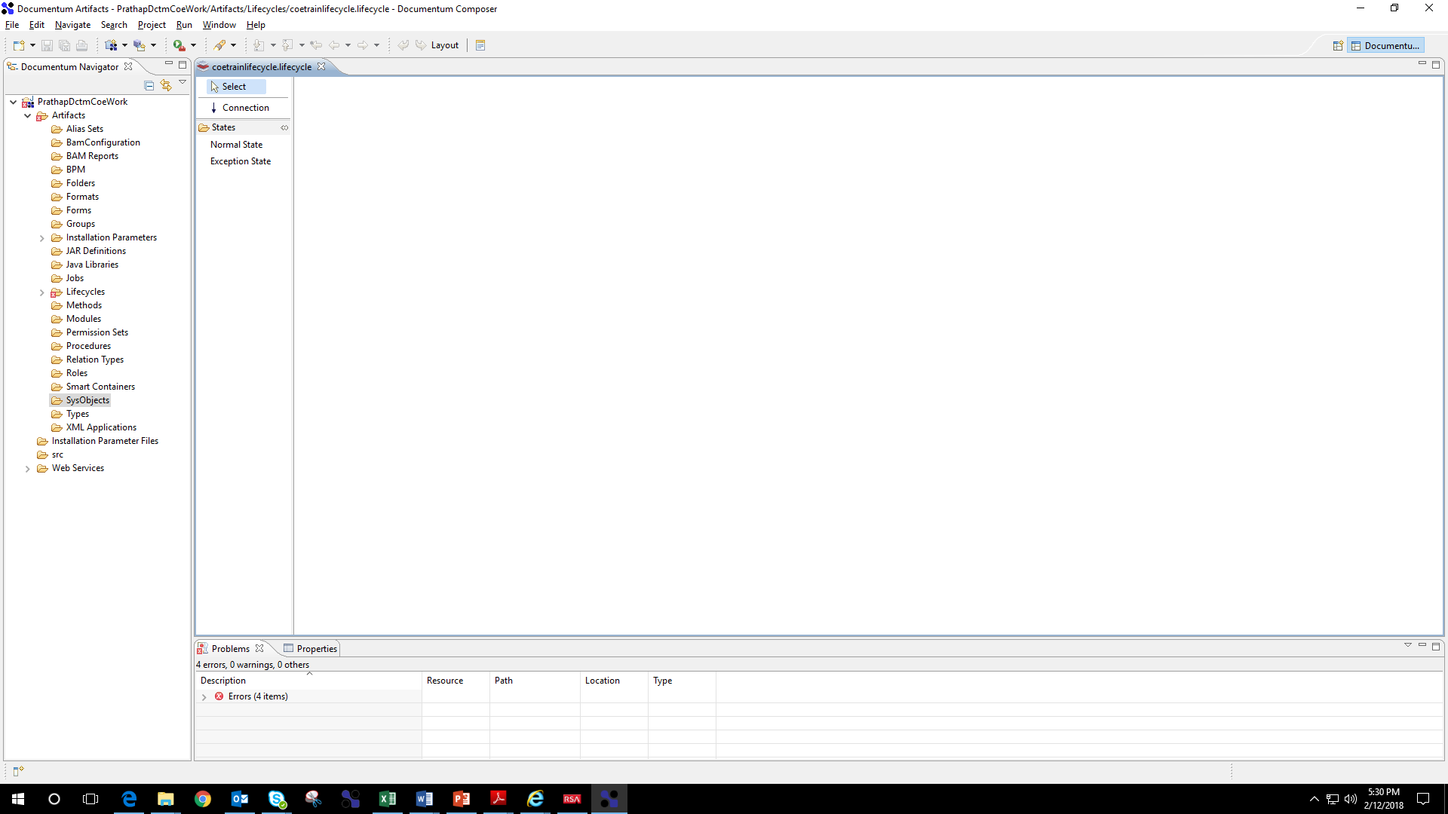
Creating a Lifecycle - 04
Now you can see an new Lifecycle got created under the lifecycle folder.

Slide 22
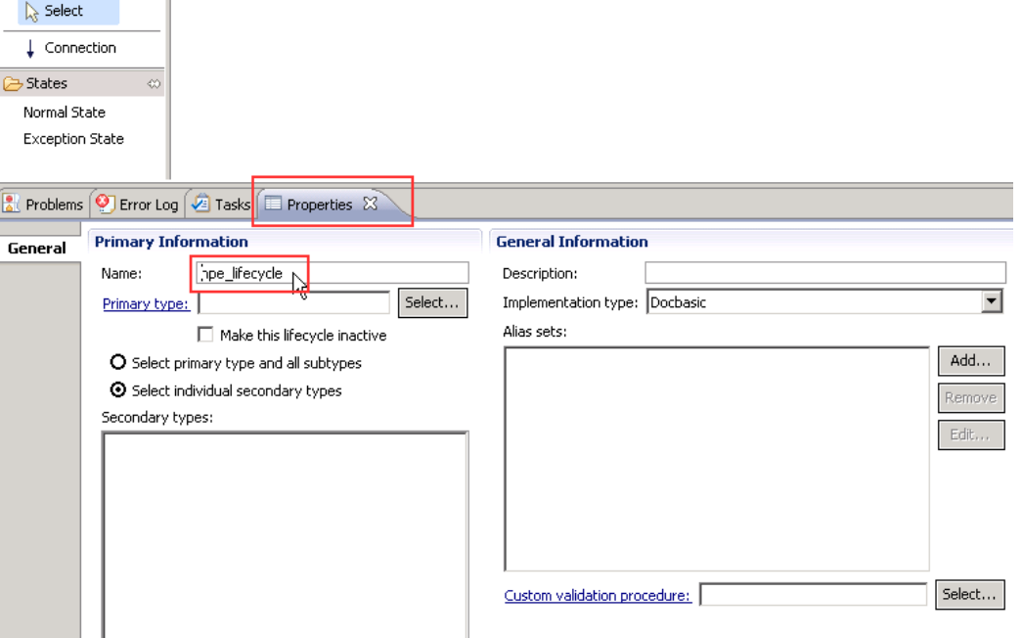
Creating a Lifecycle - 05
A new properties tap displayed on the bottom frame. This Properties tab include a General tab on the left side.

Slide 23
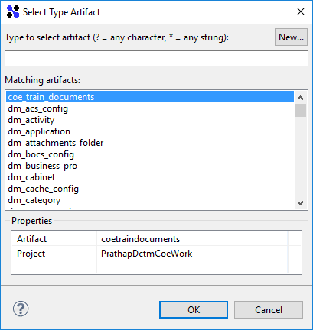
Creating a Lifecycle - 06
You can see artifact’s name as CoeTrainlifecycle
Generla tab select the coetraindocuments as your Primary type

Slide 24
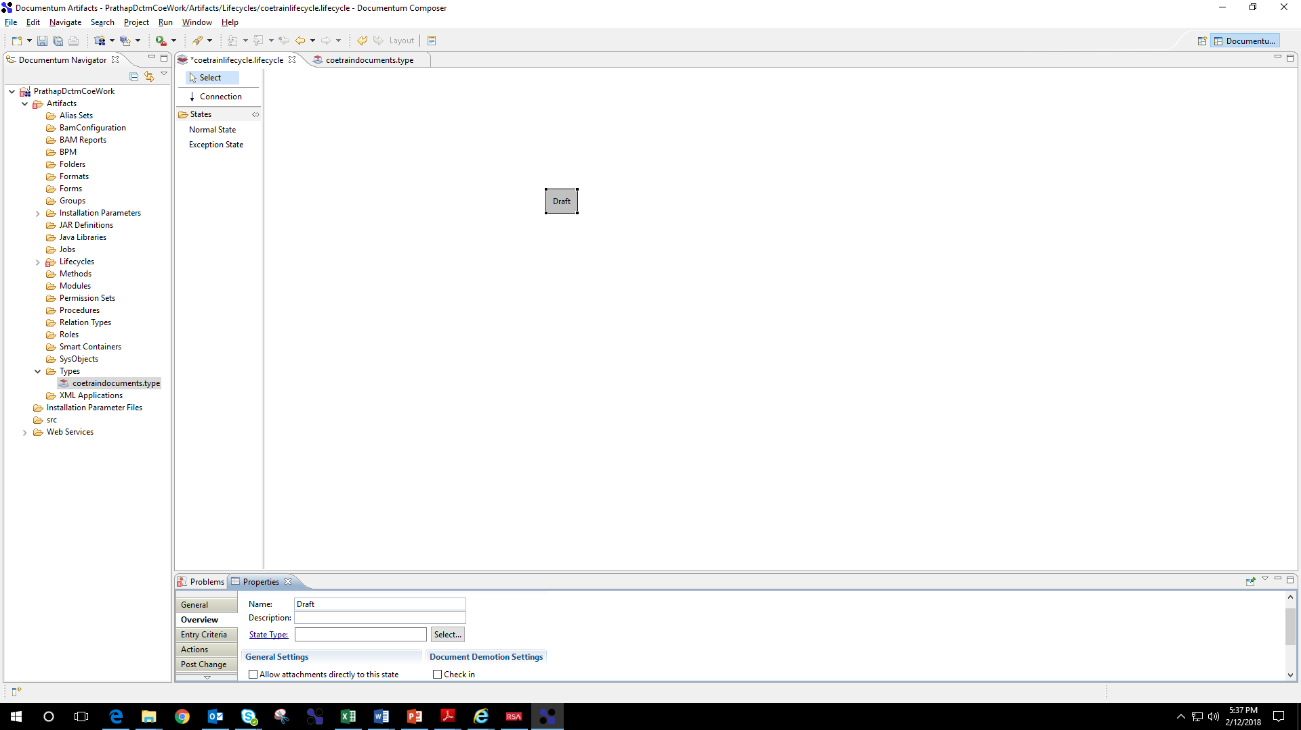
Creating a Lifecycle - 07
click in the white area and draw a new rectangle

Slide 25
Creating a Lifecycle - 08
additional tabs under general appears
enter in the Overview tab the name of the rectangle = Draft
Configuring action:
Now we will perform simple operation.
Assigning a value ( Draft ) to an attribute (document_status).
Assigning a permission set ( coe_train_acl)

Slide 26
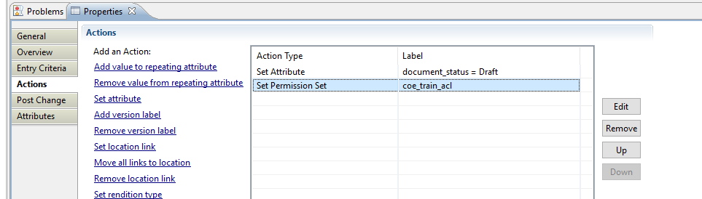
Creating a Lifecycle - 09
Click Action on the left side menu:

Slide 27
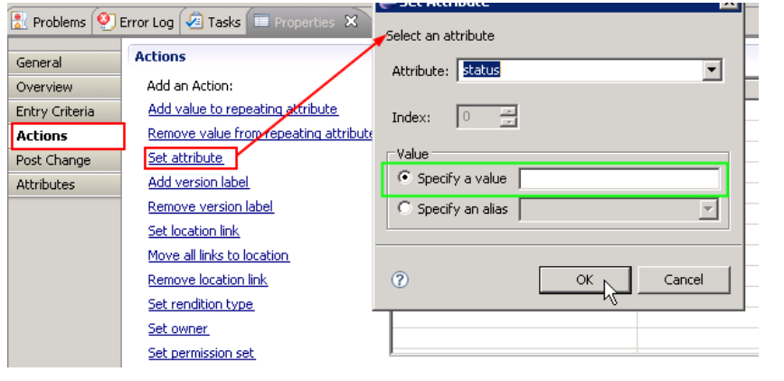
Creating a Lifecycle - 10
Setting Attribute:
Select document_status from Attribute dropdown
Type Draft in the value field

Slide 28
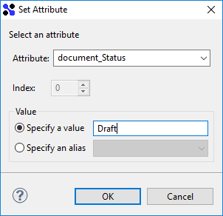
Creating a Lifecycle - 11
Similarly, click on the Set permission set and select the coe_train_acl permission set

Slide 29
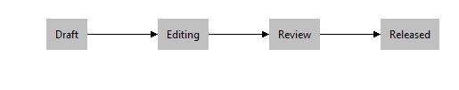
Creating a Lifecycle - 12
Add four more states: review, approved, effective and obsolete
set the status attribute to the corresponding values of the lifecycle state
Connect the lifecycle states. Draw an arrow between the states and they are connected automatically.

Slide 30
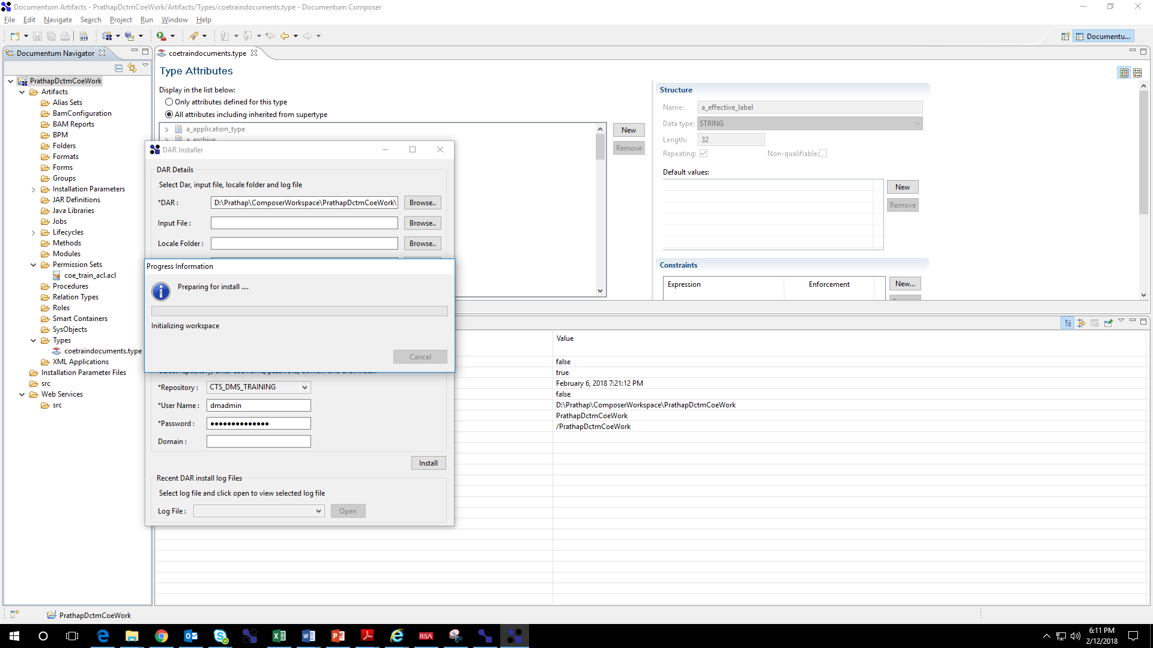
Installing Lifecycle into repository
Open Dar installer.
Locate the Dar file from your workspace
Enter the docbase credentials
Click install
Lifecycle is successfully installed in the repository

Slide 31
Installing Lifecycle Alternative way
When the Lifecycle is designed, By default it will be draft state at your local machine. we have to Validate and Install it before it can be used.
Right-click “CoeTrainlifecycle” in the left-hand tree view and select “View”.
Press the “Validate” button on the lifecycle dialog. The label on the “Validate” button should change to “Install”.
Press the “Install” button. The lifecycle is now installed and can be used by dm_documents.

Slide 32
Test Your Understanding
i_chronicle_id change when the document passes through lifecycle?
True
False
Ans: b

Slide 33
Test Your Understanding
2. Object Type of the lifecycle:
dm_process
dm_policy
dm_application
Ans: b
Ans: b

Slide 34
Test Your Understanding
3 . Which of the following defines the business rules that can be applied to different types of documents.
Workflow
Lifecycle
iDQL
Ans: b
Ans: b

Slide 35
Test Your Understanding
3 . Different Stages in LifeCycle are.
Start,WIP(Work in Progress),Staging,Approved
Running,PAused,Terminate
Start, WIP, PAuse, Terminate
Begin, WIP , End
Ans: a
Ans: b

Slide 36
Try this:
4.Different version of the same document can participate in different lifecycles
a. True
b.False
Ans: a.

Slide 37
Try this:
Create a Lifecycle
Lifecycle name: underwriting
Action:
Set Rendition
Add value to a repeating attribute
Install the lifecycle in the repository
Assign the lifecycle to a document

Slide 38
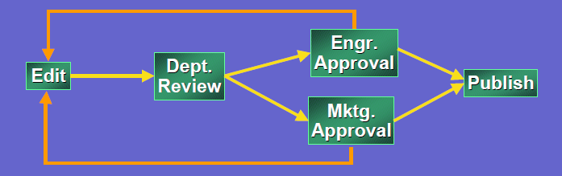
What is workflow?
Mechanism to model a business process
A network of tasks performed by a user or the system
Flow of data from task to task
Logic that governs the sequence of tasks

Slide 39
Features of workflow
You can use Workflow to model a business process. Workflow is task centric. As in the example, there are Edit, Review, etc.
You can define tasks to be performed by user manually or by the system automatically. For example, you can make Publish an automatic task.
You can send different numbers of document in a workflow.
You can set up the logic in the workflow to control the flow of the tasks. As in the Approval tasks, the next task can be forwarded to Publish or rejected to Edit.

Slide 40
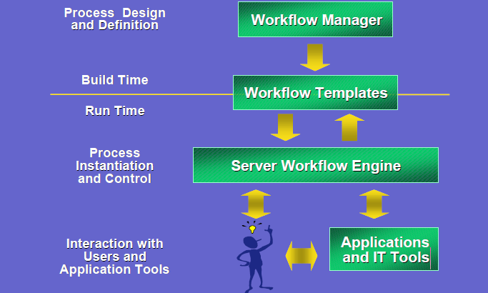
Workflow Model

Slide 41
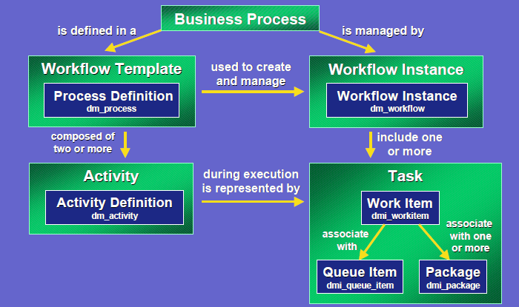
Object Model And Relationship

Slide 42
Object Model And Relationship
Here is the object model in DCTM server.
Business Process - what is intended to happen
On the left is the Design Time Definition. Workflow Template is defined by
Process Definition - dm_process, representation of what’s intended to
happen
Activity Definition - dm_activity, representation of what’s intended to
achieve at a logical step
On the right is the Run Time Management
Workflow Instance - dm_workflow, controls automated aspect of the
business process and record runtime information of workflow
Task - record run time information of activity
Work Item - dmi_workitem, task allocated to task performers
Queue Item - dmi_queue_item, peer item for work item for querying in Inbox

Slide 43
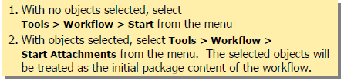
Using workflow
A workflow can be started in two ways.

Slide 44
Object types involved in Workflow:
Type | Explanation
dm_process | The workflow template we create using Process Builder is saved as dm_process object. We can call the process as blue-print of the workflow.
dm_activity | The Activity Template details are stored under this type.
dm_workflow | Created during runtime. Whenever we start a workflow, dm_workflow object is created. We can tell dm_workflow is the runtime instance of dm_process.
dm_workitem | Created during runtime. dm_workitem is runtime instance of dm_activity.
dmi_package | Created during runtime. It contains details about the documents attached to the workflow.

Slide 45
Designing a workflow:
The workflows are designed using the tool called “Documentum Process Builder”.
In process builder we have following Templates.
Manual Activity Templates, where we can select the performer.
Auto-Activity Template, where we can write our own code to be executed.

Slide 46
Pre defined Activity Templates
A set of activity templates, each performing different functions are provided in process builder. Following are some of the pre-defined activity templates
· DQL Read/Write
· Link to Folder
· Create ACL
· Process Data Mapping
· Create Folder
· Invoke Process

Slide 47
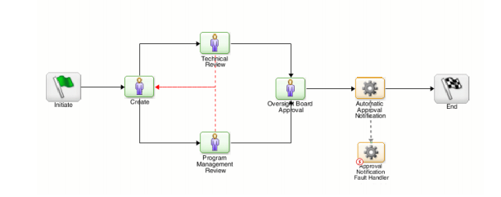
Process Template:
Process templates can describe simple or complex business processes.
serial segments: The activities follow one another in a specified sequence, Parallel segments: Two or more activities happen concurrently.
The path that a document takes through the workflow can differ depending on what happens along the way
For example, a purchase order could be routed to different activities depending on whether the manager approves it or rejects it.

Slide 48
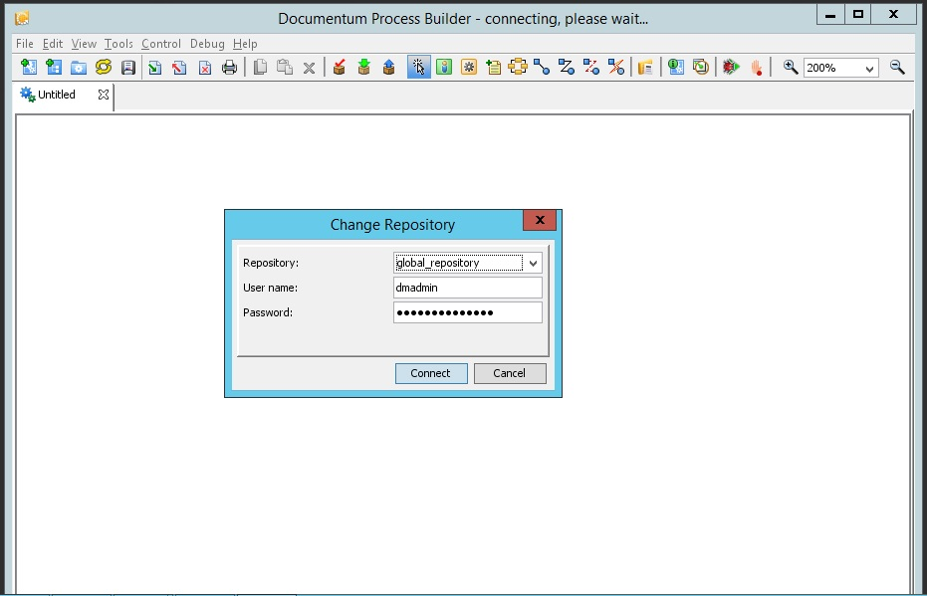
Workflow design 01
Open Process Builder and enter the docbase credential.

Slide 49
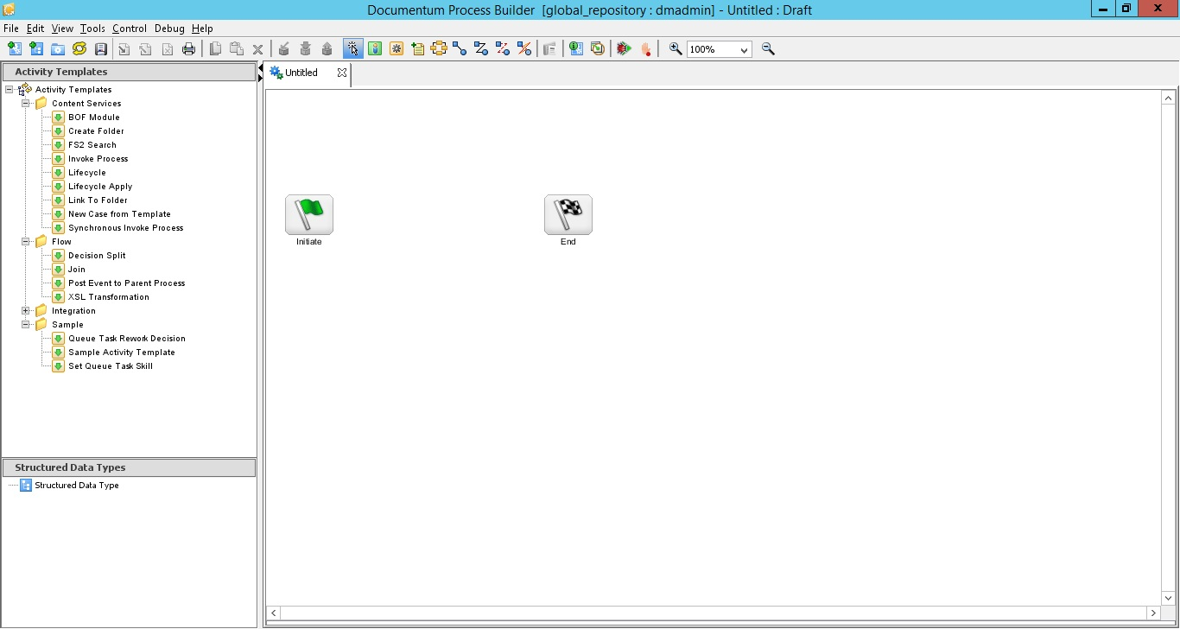
Workflow design 02
Home screen of Process builder appears

Slide 50
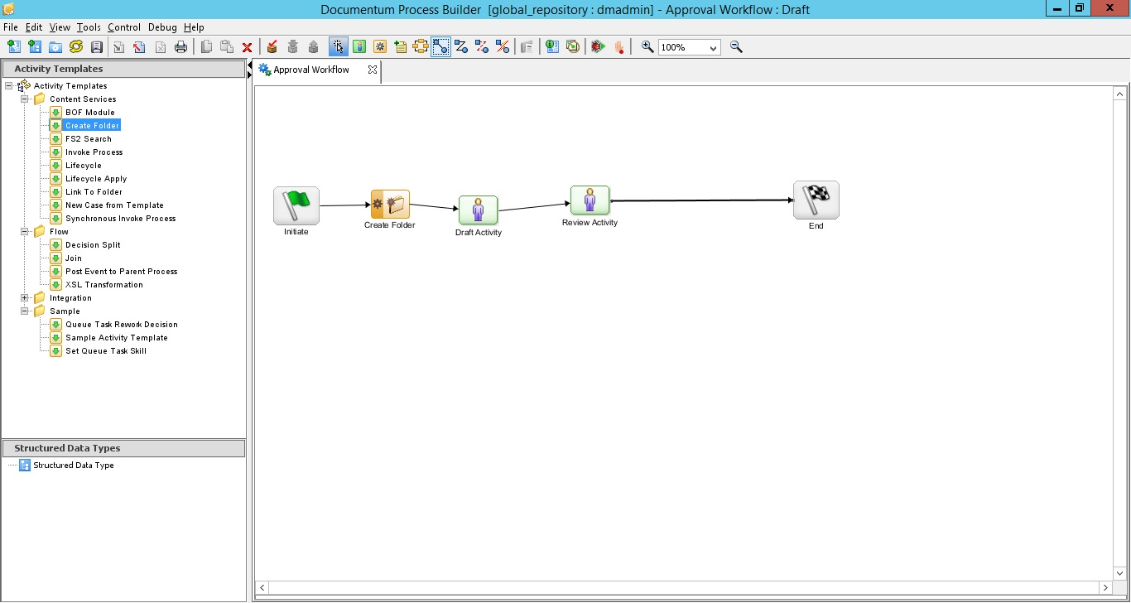
Workflow design 03
You can drag and drop necessary activity template.
For our case we use one automatic activity (create folder) and two manual activity (Draft and review activities).
Link the activity using create flow button

Slide 51
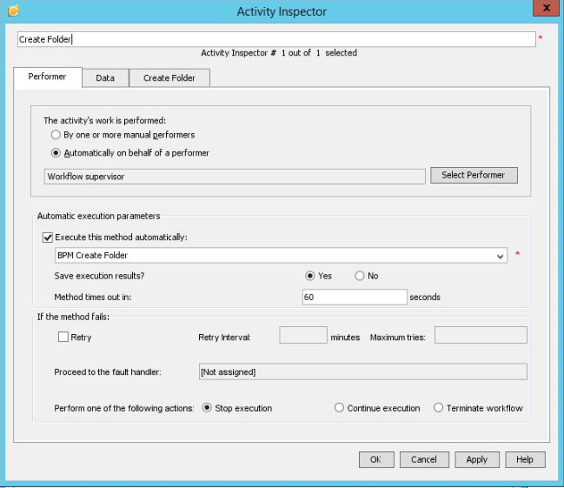
Configuring workflow activity 01
You can configure workflow activity by double clicking on the specific activity.
Configuring create folder activity
You can see BPM create folder got selected in the execute method. Which implies the specific method invoked when document reaches this state.

Slide 52
Configuring manual activity 02
Double click on draft activity ( manual activity).
In the 'activity inspector' go to performer tab.
select the tab 'by one or more manual performers‘
click on the select performer button and select 'specific user' from the drop down, make sure 'assign performers now' radio is selected and hit next
In the groups list box select '' and in the users list box select the ‘workflow administrator' user and hit finish.( you can select the specific user if needed)

Slide 53
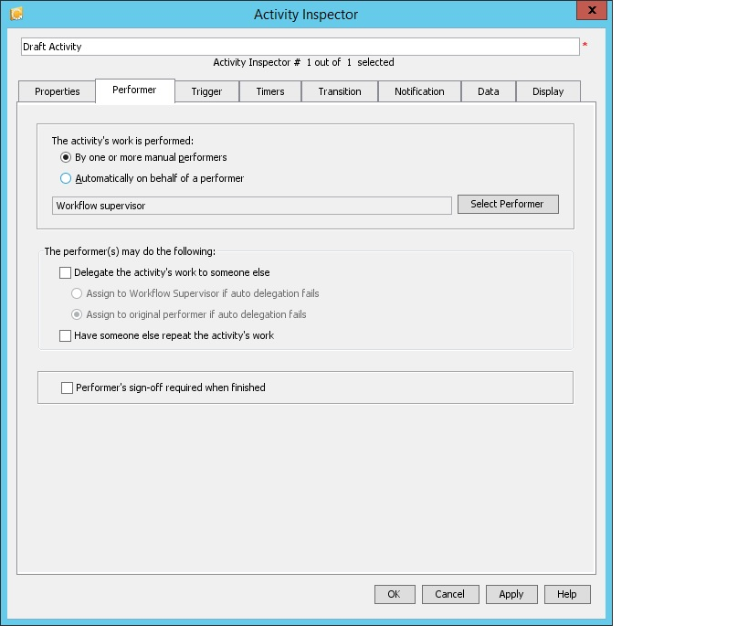
Configuring manual activity 03
select the 'transitions' tab for the drop down 'when this activity completes' select the option 'let performer select the next activities‘
hit apply and ok.

Slide 54
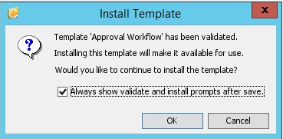
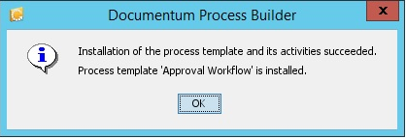
Installing the workflow template
Save(provide a name for the template and install it in a subfolder of your home folder), validate and install(process builder will automatically prompt for validation and installation when saving a process template).

Slide 55
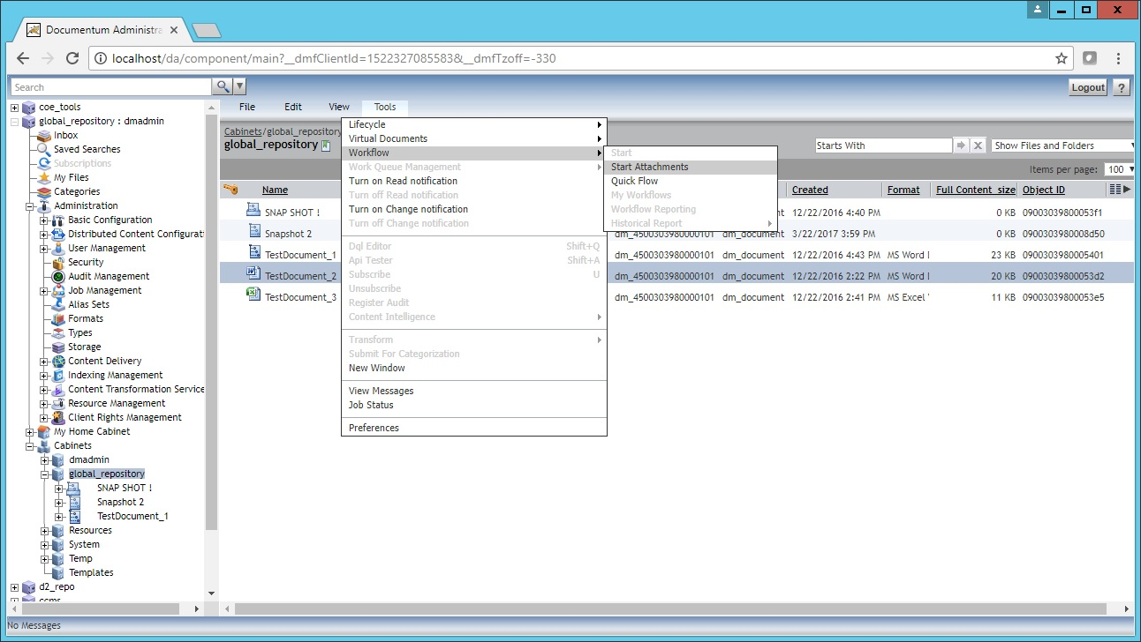
Running the work flow
Open DA or Webtop, Login in as workflow administrator user.
Select a document.
Go to Tools→workflow→start attachment.
Select your workflow. ( this will trigger the workflow you have created)

Slide 56
Test Your Understanding
1 . The automatic activity is performed by a person or multiple people.
True
False
Ans: b
Ans: b
Ans: b

Slide 57
Test Your Understanding
2 . Object type of workflow Process Definition
dm_policy
dm_process
dm_application
Ans: b
Ans: b
Ans: b

Slide 58
Test Your Understanding
3 . Object type of workflow Instance
dm_policy
dm_process
dm_workflow
Ans: c
Ans: b
Ans: b

Slide 59
Test Your Understanding
4 . To launch a workflow, user must select an object to route.
True
False
Ans: b
Ans: c
Ans: b
Ans: b

Slide 60
Try this
Create a new workflow
Requirement:
2 Automatic activity ( any activity)
2 manual activity( any activity)
Install the workflow in repository, Create a document and route it in the workflow.

